Slide 1
Volume Renderings of Sheared Thermal Convection
Jean M. Favre, Swiss National Supercomputing Center
Alexander Blass, University of Twente
Scientific Visualization & Data Analytics Showcase
SC18, Nov. 14, 2018
Notes:
Good morning everyone
I am presenting a visualization showcase called “”, this is work in collaboration with my co-author Alexander Blass who is in the Physics of Fluids Group, Max Planck Center for Complex Fluid Dynamics
1

Slide 2
Outline
Thermal convection around us
Volume Rendering Principles
Volume Rendering of Thermal Convection: The movie
Presentation of three Volume Rendering implementations tested
Benchmark and Evaluation
Conclusion
Notes:
The outline of my presentation will include a brief set of examples showing how thermal convection is present in many natural settings around us. I will follow with a very quick introduction about the principles of volume rendering, present the movie itself, and discuss the 3 implementations we have benchmarked before concluding my presentation.

Slide 3
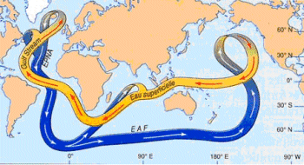
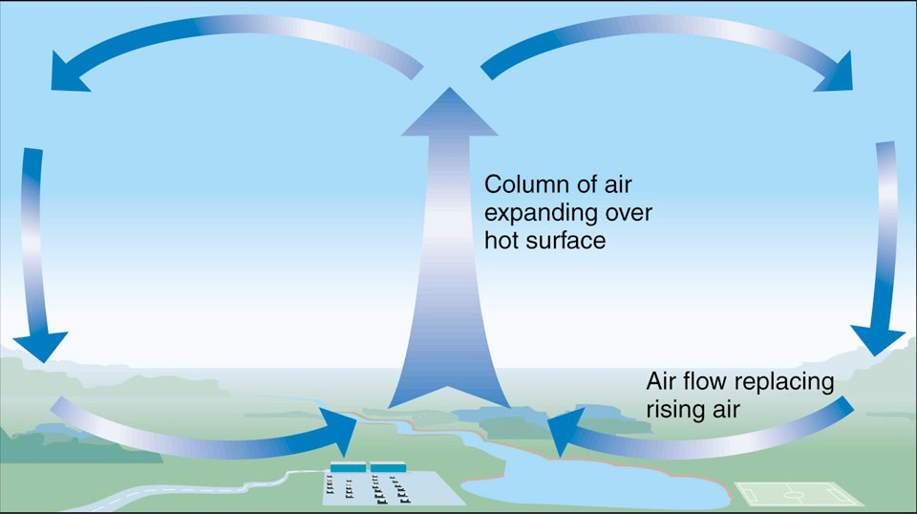
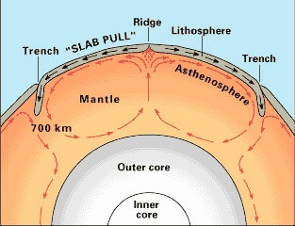
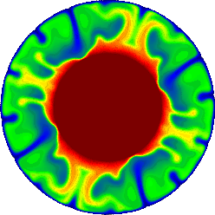
Turbulent thermal convection in geophysics
Ocean
Atmosphere
Earth core
Earth mantle
Notes:
At large scale, thermal convection is found in many physical processes around us, such as deep ocean currents, advection in the atmospheric layer above the earth surface, but also under the surface, in the earth mantle and core

Slide 4
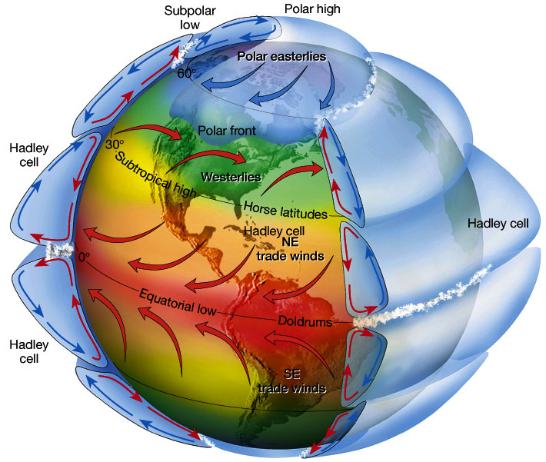
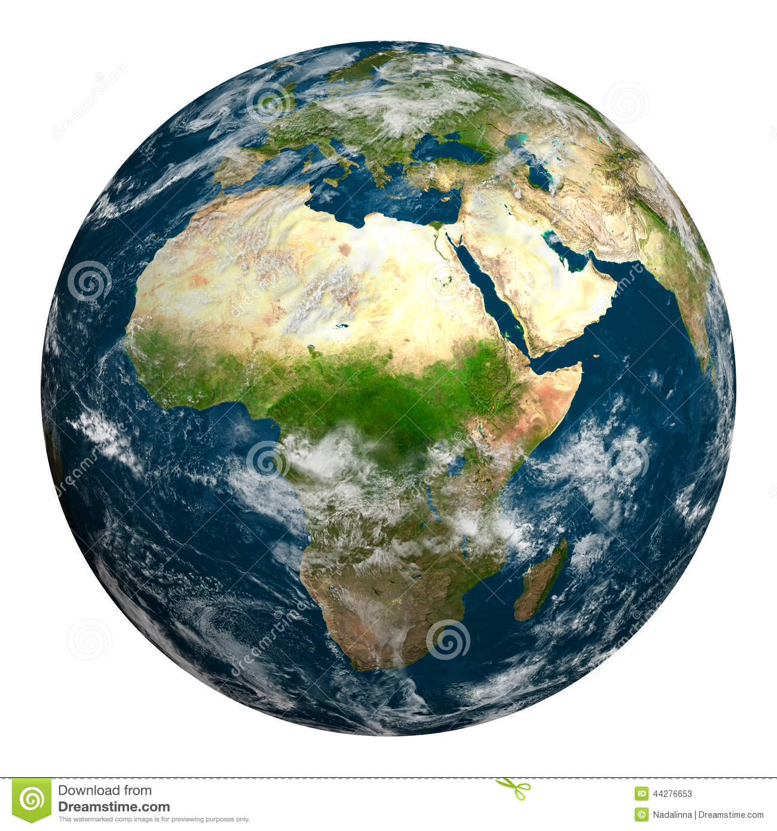
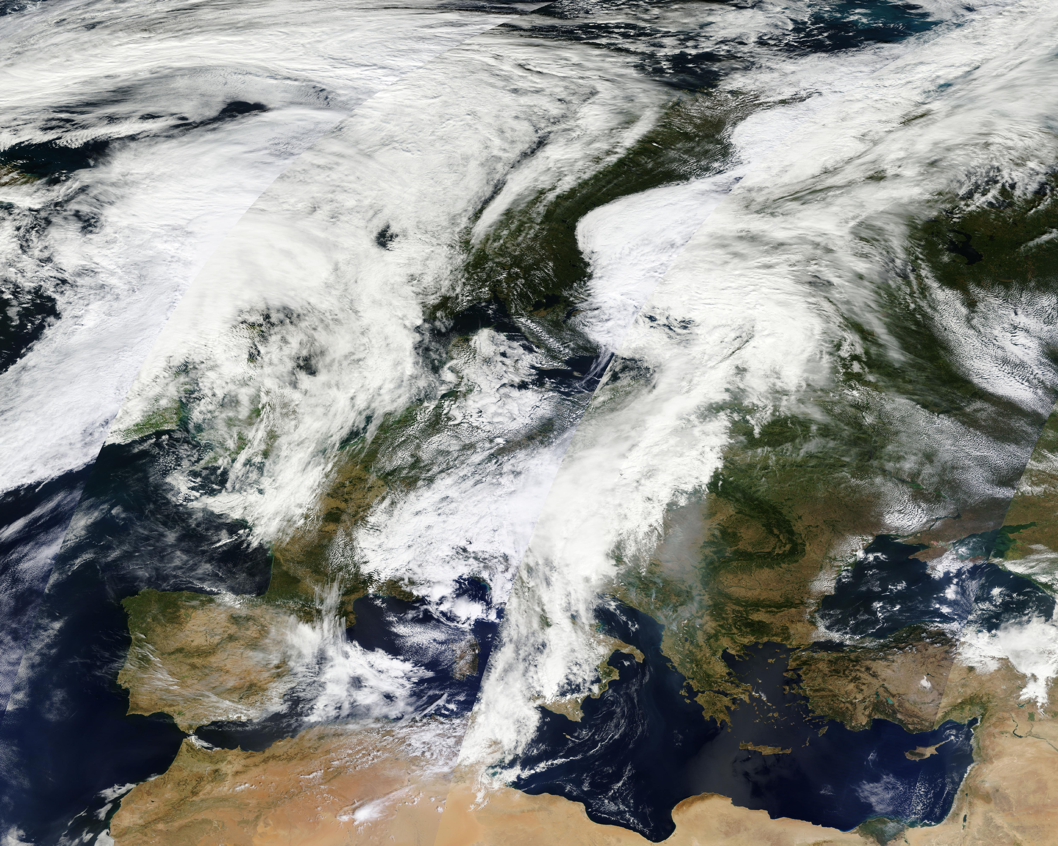
Convection in the atmosphere
Notes:
Convection in the atmosphere is of course of great actuality and interest because it directly impacts the earth global population with severe weather patterns.

Slide 5
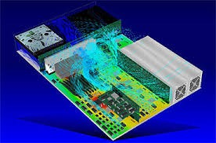
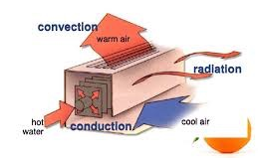
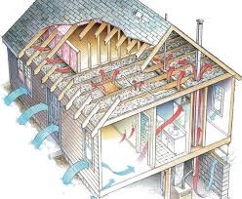
Turbulent heat transfer in engineering
Notes:
At much smaller scale, we also observe convection for example in building heating and air-conditioning systems, or down at the chip level (since we are at a computing conference), in the cooling infrastructure of devices

Slide 6
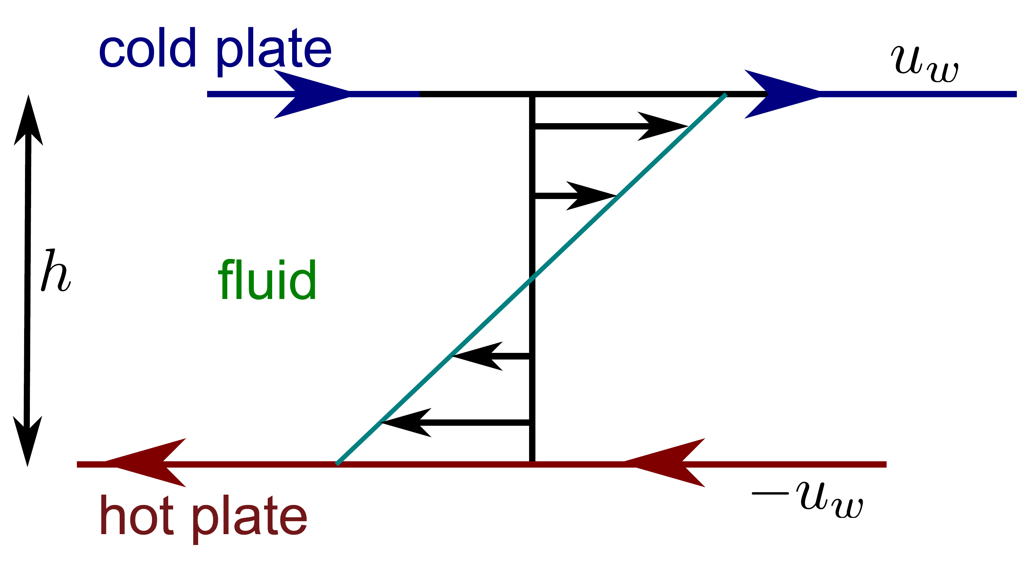
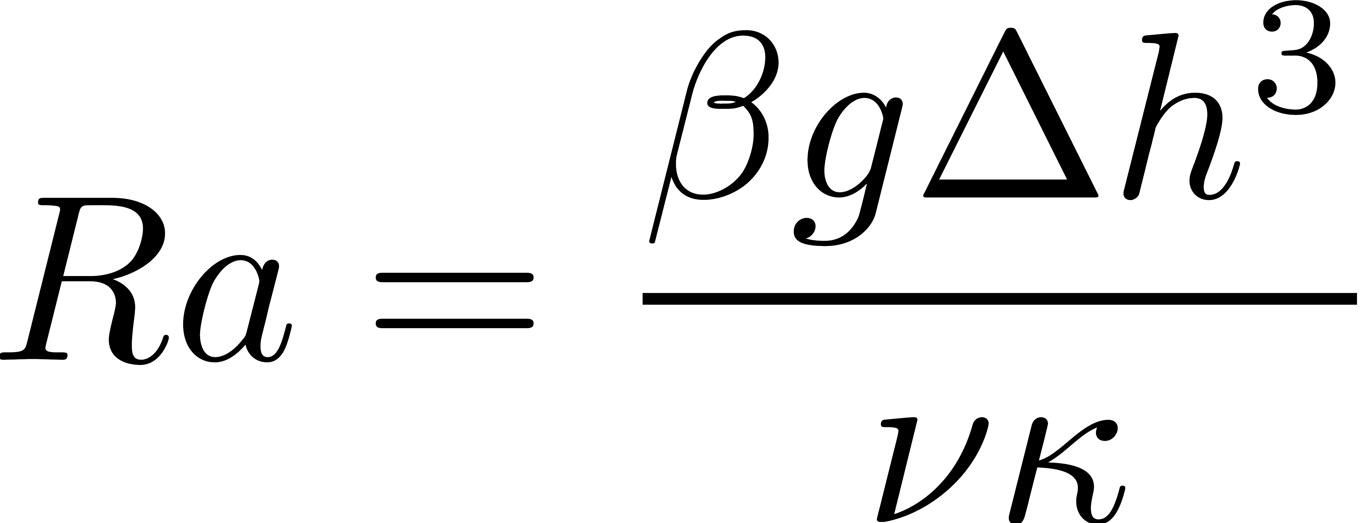
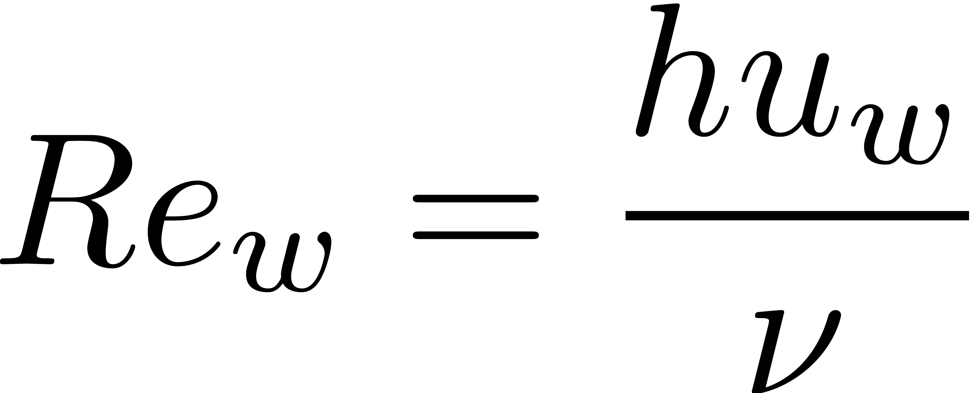
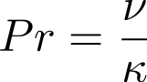
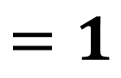
Sheared thermal convection
Rayleigh-Bénard with Couette flow shearing:
Control parameters
Rayleigh number
Wall Reynolds number
Prandtl number
$$=1$$
Aspect ratio
Notes:
The case we have simulated is sheared thermal convection between two plates. The input parameters are the Rayleigh number, the Reynolds wall number (non-dimensional wall velocity) and the Prandtl number (non-dimensional fluid properties)
The temperature goes from 0 to 1 because it is normalized by the temperature difference between the plates and therefore non-dimensional.
This allows us to research the flow in more general manners, since the turbulent structures depend on the temperature difference.
The flow forcing is realized by moving both plates in opposite direction at opposite speeds, thus keeping the bulk velocity at 0

Slide 7
Visualization of the temperature field
Used a high spatial resolution grid (6952x3456x384) grid points.
Rendering scalar fields at very large voxel counts is often impractical with feature extraction filters which create geometric objects. The compute cost and polygonal count become overwhelming.
Volume rendering is preferred
Used the ParaView Visualization application since it enables the testing of multiple Volume rendering features and implementations.
Notes:
The simulation grid we have used has a pretty large resolution of nearly 10 billion points.

Slide 8
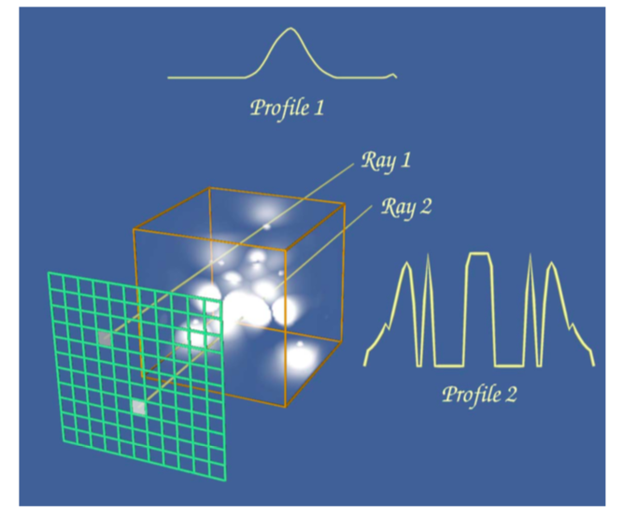
Volume Rendering Principles
Volume rendering is used to generate images that represent an entire 3D dataset.
Data can be processed in image-order, or volume-order.
Image order is often referred to as ray-casting.

Slide 9
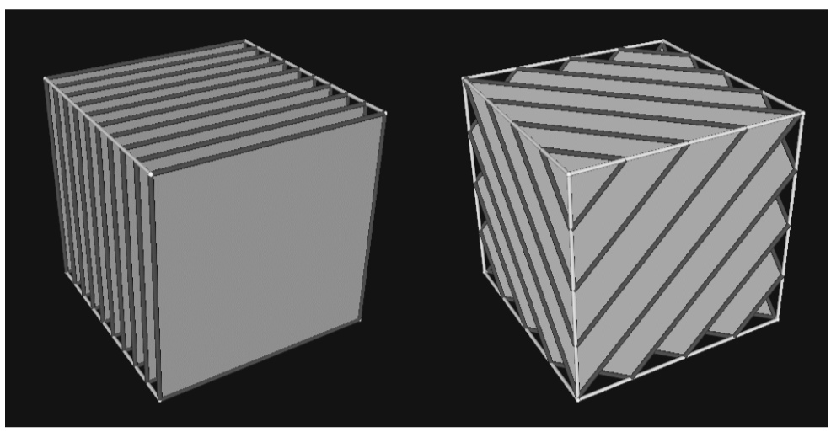
Volume Rendering Principles
Volume rendering is used to generate images that represent an entire 3D dataset.
Volume order algorithms process samples in the volume based on the voxels.
Here, a texture mapping technique is used.
Notes:
Alternatively, volume order algorithms……
A set of co-planar slices is constructed throughout the volume in a direction perpendicular to the view point vector and then rendered in back-to-front order.

Slide 10
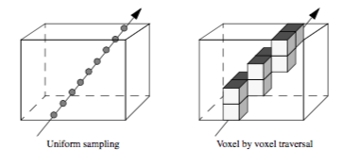
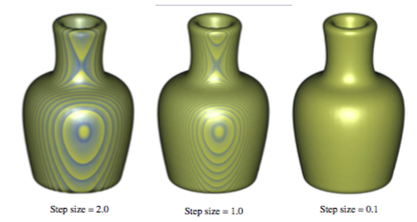
Sampling Density in Volume Rendering
In both image-order or volume-order techniques, the sampling density will have a strong effect on the final image.
P.S. Images in the last 3 slides from the VTK Textbook.
Notes:
Ray traversal or voxel sampling throughout the volume will accumulate color and opacities information and it should be rather obvious that the sampling density will produce images of different quality

Slide 11
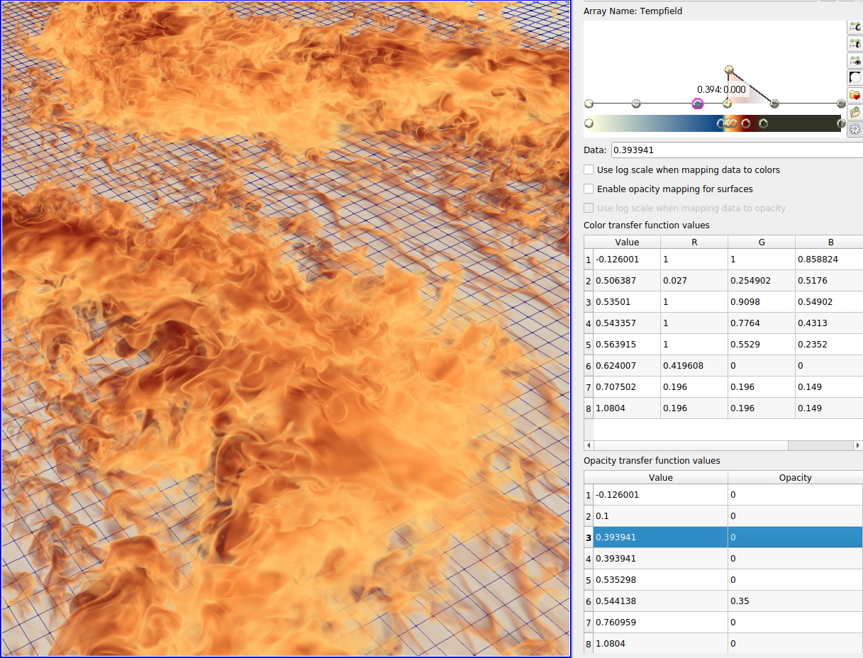
Transfer functions for color and opacities
The final ingredient in setting up a Volume Rendering is a set of transfer functions to map scalar values to colors and opacities.
The ParaView GUI lets us define a set of piecewise linear functions.
Notes:
The crucial ingredient in calculating the final color of the samples is based on a set of xfer functions mapping scalar field values to RGB and opacities. These xfer functions are often piecewise linear functions mapping scalar values to colors and intensity

Slide 12
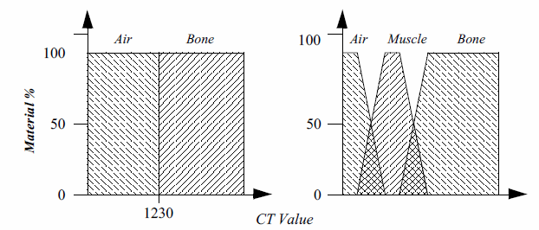
Volume Rendering Principles
The final ingredient is a set of transfer functions to map scalar values to colors and opacities.
P.S. Images in the last 4 slides from the VTK Textbook.
Notes:
The crucial ingredient in calculating the final color of the samples is based on a set of xfer functions mapping scalar field values to RGB and opacities. These xfer functions are often piecewise linear functions mapping scalar values to colors and intensity

Slide 13
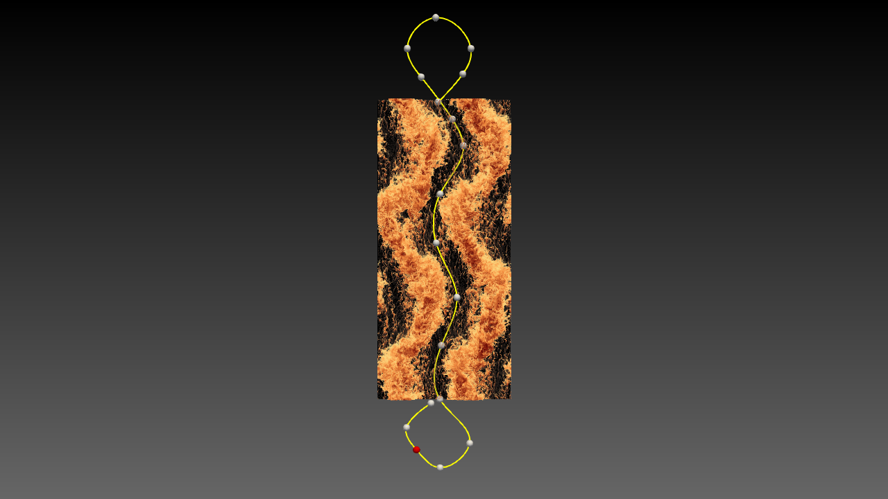
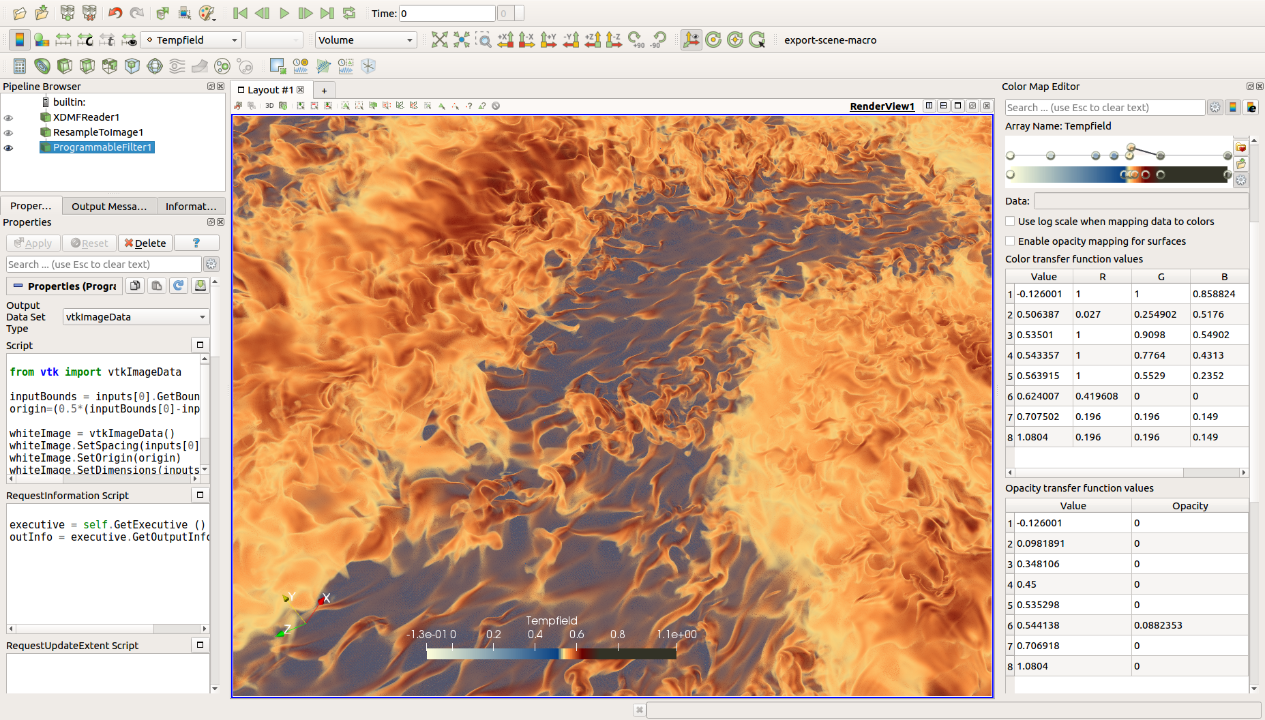
Volume-rendering the temperature field
Notes:
In this showcase of rendering the temperature field, scalar values go from 0 to 1 because it is normalized by the temperature difference between the plates and therefore non-dimensional.

Slide 14
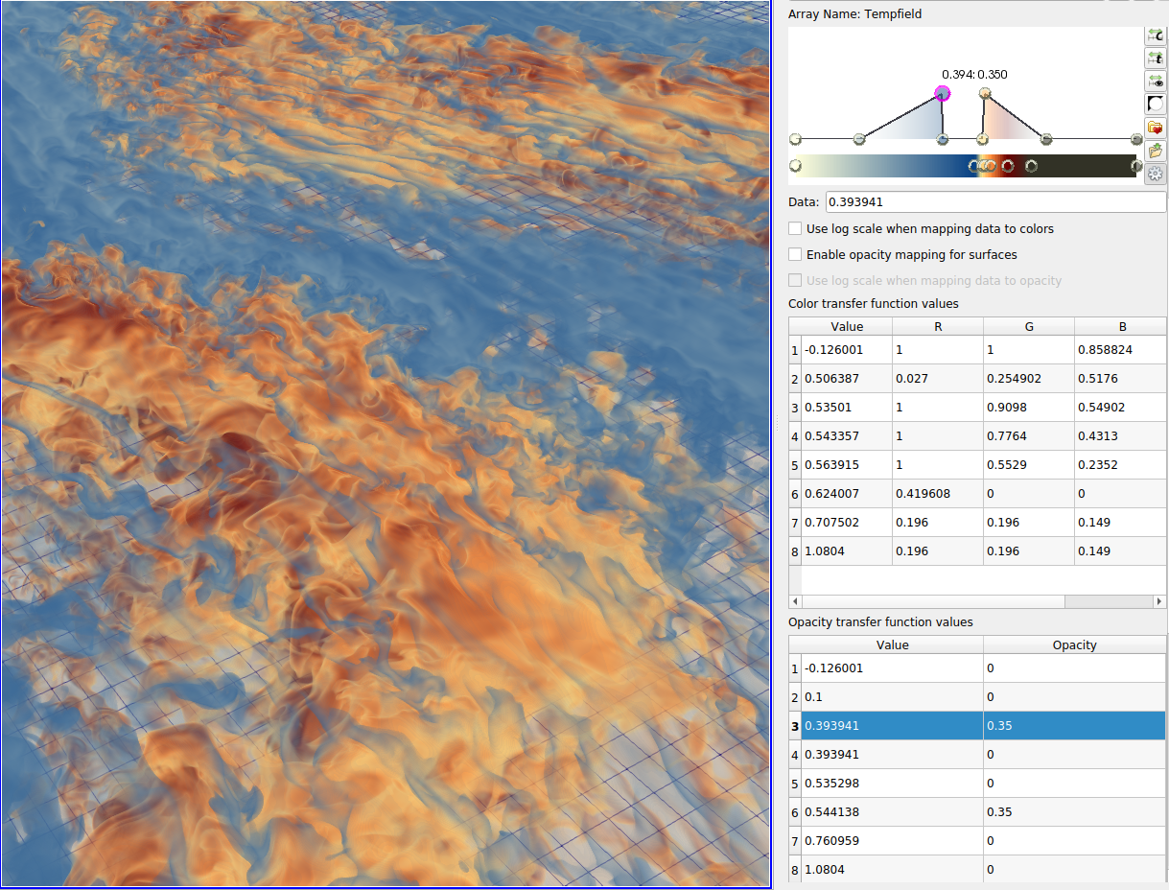
Tuning the colormap
Hot or cold fluids are rendered with a tent-like function
Notes:
By explicitly separating the cold and hot fluids with non-overlapping xfer functions, we are able to visualize both colder and hotter fluids in a very flexible manner.

Slide 15
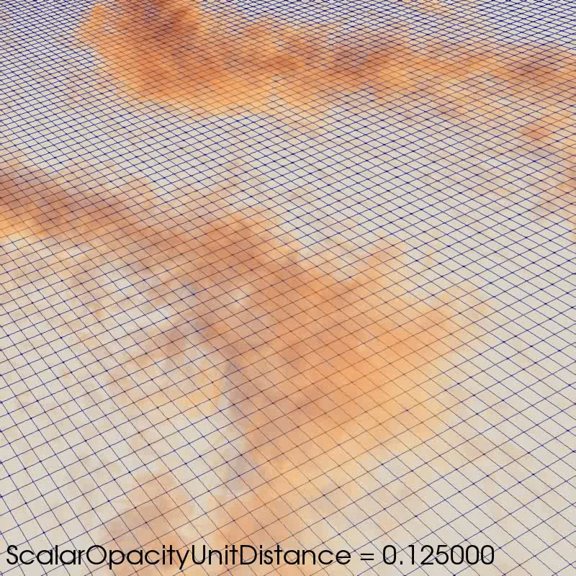
Tuning ParaView’s Scalar Opacity Unit Distance
Colors are sampled along the viewing rays and accumulated (composited) as a function of transparency. We want a high constrast image…
But avoiding saturation.
The effect of the Scalar Opacity Unit Distance depends obviously on the scale of the Opacity values in the transfer functions defined earlier.

Slide 16
Requirements for a fast and effective user experience
Colormap and opacity transfer function editing should be:
Immediate
Reproducible
Changing the Sampling Unit Distance should be immediate
Interactive navigation within the volume should be interactive
Reduced resolution rendering (LOD)
Cropping
Progressive rendering
For our timing benchmarks, movie production was emphasized. I/O costs were not measured.
Notes:
We are pleased to report that such interaction was easily done with all three libraries tested.
While ParaView itself provides acceleration shortcuts such as LOD or cropping the volume, the evaluation and benchmarking we report in the paper are in a movie production mindset, i.e. at full spatial resolution and without any of the progressive rendering tricks the implementations might provide.

Slide 17
Thermal Convection animated
Show the movie
Notes:
3) why are the streaks actually in a static position in the volume?
This was a bit surprising to see for us too, but it turns out that while the flow itself moves forward (or backward depending on which plate it is closer to), the temperature structures themselves actually dont move.
These features were revealed by the 3D visualization, and they had not been anticipated by using traditional statistical means.

Slide 18
Three Volume Rendering implementations were evaluated
First Option:
ParaView’s native support with GPU-based ray-casting
VTK’s SmartVolumeMapper will detect what hardware is available and will:
Do GPU ray casting if supported, or
Use a FixPointRayCastMapper (Threaded, software mapper)
We opted for GPU ray casting in all our tests

Slide 19
Three Volume Rendering implementations were evaluated
Second Option:
NVIDIA IndeX library (GPU-based ☺)
Uses CUDA, NVLink, OptiX to get the best of the GPU
https://developer.nvidia.com/index

Slide 20
Three Volume Rendering implementations were evaluated
Third Option:
Intel OSPRay library (fully multi-threaded on the CPU)
A CPU rendering lib with advanced shading effects such as AO, shadows and transparency.
OSPRay internally builds on top of Embree and ISPC (Intel® SPMD Program Compiler), and fully utilizes modern instruction sets like Intel® SSE4, AVX, AVX2, and AVX-512 to achieve high rendering performance.
Notes:
And can take full advantage of modern instructions sets like AVX, AVX2 on our supercomputer nodes

Slide 21
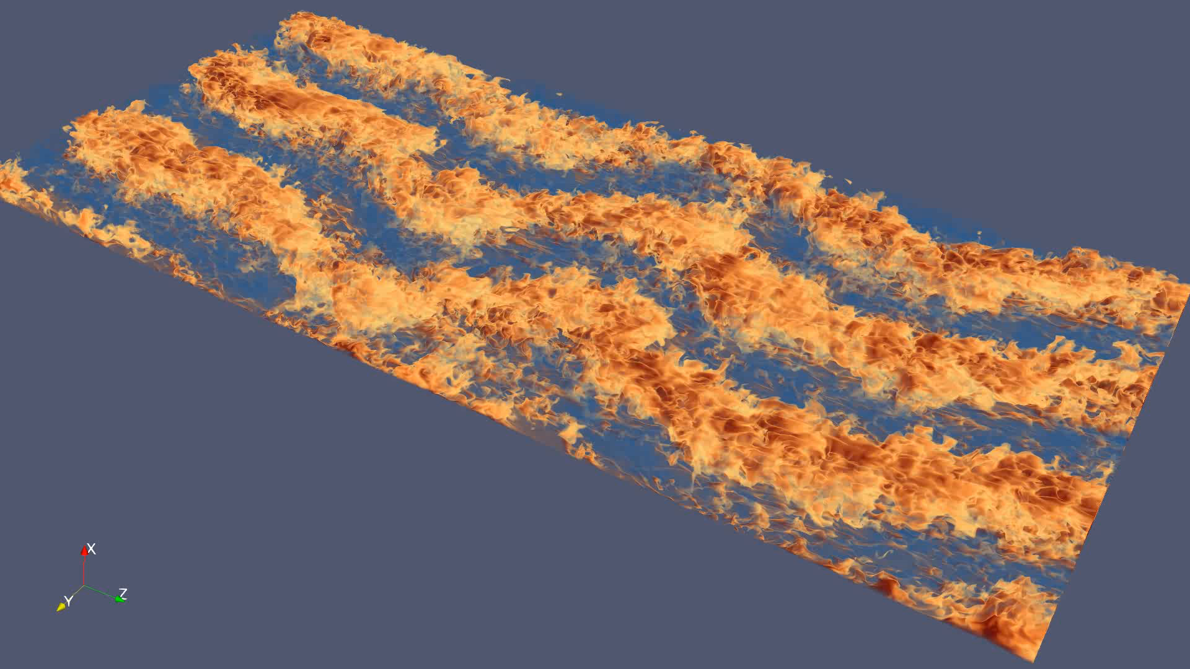
Benchmarking procedure
Benchmark based on a key-frame animation between different camera viewpoints, for 300 animation steps.
Benchmarking is script-driven to:
avoid user latency and errors.
provide repeatability.
change parameters and record history.
Differentiate between “Still Render” and “Interactive Render”
By default, ParaView optimizes for high latency client-server connections and provides compressions and level of details reduced-quality images. To circumvent that, we ran all benchmarks on the server-side only.
Notes:
Our evaluation of the performance of each implementation consisted in a key-frame navigation throughout the volume for 300 images at different orientations and zoom levels.

Slide 22
Compute Node characteristics
CSCS’s Piz Daint compute nodes
Cray XC50 Compute (5320 Nodes)
Intel® Xeon® E5-2690 v3 @ 2.60GHz (12 cores, 64GB RAM)
NVIDIA® Tesla® P100 16GB
XC40 Compute Nodes (1813 Nodes)
Two Intel® Xeon® E5-2695 v4 @ 2.10GHz (2 x 18 cores, 64/128 GB RAM)
With the possibility to use Hyperthreading, we have 72 compute threads
Notes:
Piz Daint nodes are a mixed set of compute nodes, with a large partition of nodes with one 12-core Intel Haswell CPU coupled with an NVIDIA Pascal GPU, and a much smaller partition with two Intel Broadwell chips

Slide 23
Performance evaluation on a single node, ¼ of the total grid size
We measure time to get the first image on the screen, to measure initialization cost and internal data structures build-up
Only ¼-th of the grid can fit on the GPU
The time to deliver the first image is of paramount importance in a movie making scenario:
data is evicted from memory as soon as the image is done
NVIDIA IndeX has higher cost because of bigger CPU-GPU transfers
Start | Startup time | Memory cost
OSPRay | 2.1 sec | 27.6 GB
ParaView Native | 7.7 sec | 25.8 GB
NVIDIA IndeX | 15.7 sec | 21.1 GB

Slide 24
NVIDIA-SMI 396.44 Driver Version: 396.44
Tesla P100-PCIE... On
| N/A 32C P0 37W / 250W | 8856MiB / 16280MiB
| 0 4363 G ...c/ParaView-v5.6.0Build-EGL/bin/pvserver 8856MiB
| NVIDIA-SMI 396.44 Driver Version: 396.44
| 0 Tesla P100-PCIE... On
| N/A 32C P0 33W / 250W | 15945MiB / 16280MiB
| 0 4363 C+G ...c/ParaView-v5.6.0Build-EGL/bin/pvserver 15917MiB

Slide 25
Performance for batch rendering with OSPRay multi-threaded
We measure the average rendering time for the 300 animation steps
N.B. With image order ray casting, the render time is directly related to the number of pixels.
The full volume can be visualized with a single node with 128GB.
Turning hyper-threading ON is beneficial.
Run-time cost does not grow linearly with pixel resolution.
Pixel Resolution / # threads | 36 threads | 72 threads
WXGA (1280x800) pixels | 2.85 sec | 1.69 sec
FHD (1920x1080) pixels | 3.37 sec | 1.90 sec
4K UHD (3840x2160) pixels | 4.81 sec | 2.73 sec

Slide 26
Performance for parallel rendering
We measured the average rendering time for the 300 animation steps
NVIDIA IndeX uses full resolution data (32-bit floats)
9 billion cells * 4 bytes = 36 GB => does not fit on 4 GPUs
Startup time is a killer (ghost-cell re-read and exchange)
After initial setup, NVIDIA IndeX is a clear winner in terms of interactivity
Rendering library | Startup time | Average render time
ParaView Native 4 GPU | 6.3 sec | 0.19 frames/sec
ParaView Native 8 GPU | 3.2 sec | 0.30 frames/sec
NVIDIA IndeX 4 GPU | n/a | n/a
NVIDIA IndeX 8 GPU | 49 secs | 1.48 frames/sec

Slide 27
Future work
LOD (Level of details), reduced pixel resolution and other tricks are already common to increase rendering speed during interaction.
Computations at reduced bit resolution and other data compression techniques are available to speed up computations and decrease traditional I/O costs.
Idea: Data reduction techniques should be evaluated to reduce the CPU-GPU transfer bottlenecks and the GPU memory limitations.
We are currently proceeding with a benchmark of the volume rendering with data at reduced bit resolution
Notes:
Since the NVIDIA IndeX implementation renders at full resolution without downsampling, we feel that it is only fair to compare the two GPU implementations by using only data encoded in 16-bit unsigned integers. That way, both the Native ParaView implementation and the IndeX implementation render the same data.

Slide 28
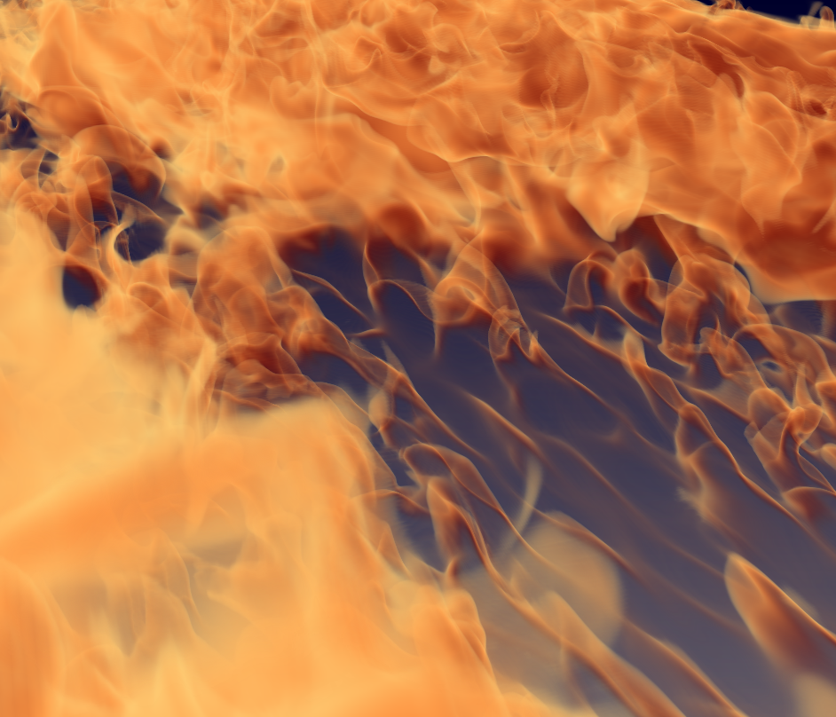

32-bit floats vs. 16-bit unsigned int
Notes:
Here we are using NVIDIA IndeX. The differences are not visibile to the human eye.

Slide 29

Image Magick pixel difference
Notes:
Image Magick detects some difference in the very thin, very transparent filament seen in the middle of the image, and on some edges of the more opaque cloud. Anyway, this encouraging, and in fact, thanks to this downsampling filter, we can again render our full dataset using 4 compute nodes running NVIDIA Index

Slide 30
Summary and conclusion
Provided a visualization platform for a thermal convection simulation, enabling interactive analysis and tuning of volume rendering parameters.
The ParaView end user application was used as a front-end to evaluate three different volume rendering libraries to support high resolution data on CPU and GPU hardware.
Demonstrated valid performance for a CPU-based library, OSPRay.
GPU-based libraries have higher startup costs and are memory-limited, but offer higher interactive frames rates.
Our production-ready solution is a compromise between (parallel) I/O costs and parallel rendering costs.
Coupling simulation and in-situ visualization has strong memory costs which need evaluation.

Slide 31
Acknowledgments
Dutch Organization for Scientific Research (NWO-I)
Dutch national e-infrastructure of SURFsara
Priority Programme SPP 1881 Turbulent Superstructures of the Deutsche Forschungsgemeinschaft
CSCS Compute allocations s713 and s802
ParaView dev. team at Kitware, USA
Dave Demarle with reference to the ParaView OSPRay plugin
NVIDIA IndeX dev. team
Mahendra Roopa@NVIDIA

